Slide 1
Streaming Architecture Demo
Jeffrey Lai
Cloud Solution Architect

Slide 2

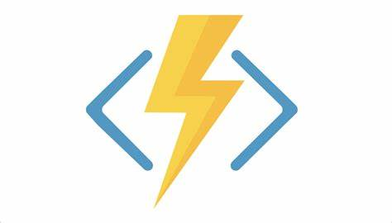



Lab Architecture
 | Azure Event Hubs lets you stream millions of events per second from any source so you can build dynamic data pipelines and respond to business challenges immediately. Event Hubs—Real-Time Data Ingestion | Microsoft Azure
 | Azure Functions Develop more efficiently with an event-driven, serverless compute platform that helps solve complex orchestration problems. Azure Functions – Serverless Functions in Computing | Microsoft Azure
 | Azure Stream Analytics Build an end-to-end serverless streaming pipeline with just a few clicks. Azure Stream Analytics | Microsoft Azure
 | Azure Data Explorer Analytics service for real-time data sets. Explore data on the fly to improve products, enhance customer experiences, monitor devices and boost operations. Quickly identify patterns, anomalies and trends in your data. Data Explorer - Analytics Service | Microsoft Azure
 | Azure Digital Twins Azure Digital Twins is an Internet of Things (IoT) platform that enables you to create a digital representation of real-world things, places, business processes and people. Digital Twins – Modeling and Simulations | Microsoft Azure
Kafka/Event Hub to Event Hub
Device

Slide 3
Lab Architecture
Kafka/Event Hub to Event Hub
Device

Slide 4
 | Azure Event Hubs lets you stream millions of events per second from any source so you can build dynamic data pipelines and respond to business challenges immediately. Event Hubs—Real-Time Data Ingestion | Microsoft Azure
 | Azure Functions Develop more efficiently with an event-driven, serverless compute platform that helps solve complex orchestration problems. Azure Functions – Serverless Functions in Computing | Microsoft Azure
 | Azure Stream Analytics Build an end-to-end serverless streaming pipeline with just a few clicks. Azure Stream Analytics | Microsoft Azure
 | Azure Data Explorer Analytics service for real-time data sets. Explore data on the fly to improve products, enhance customer experiences, monitor devices and boost operations. Quickly identify patterns, anomalies and trends in your data. Data Explorer - Analytics Service | Microsoft Azure
 | Azure Digital Twins Azure Digital Twins is an Internet of Things (IoT) platform that enables you to create a digital representation of real-world things, places, business processes and people. Digital Twins – Modeling and Simulations | Microsoft Azure

Slide 5
Example Architecture - Extended

Slide 6
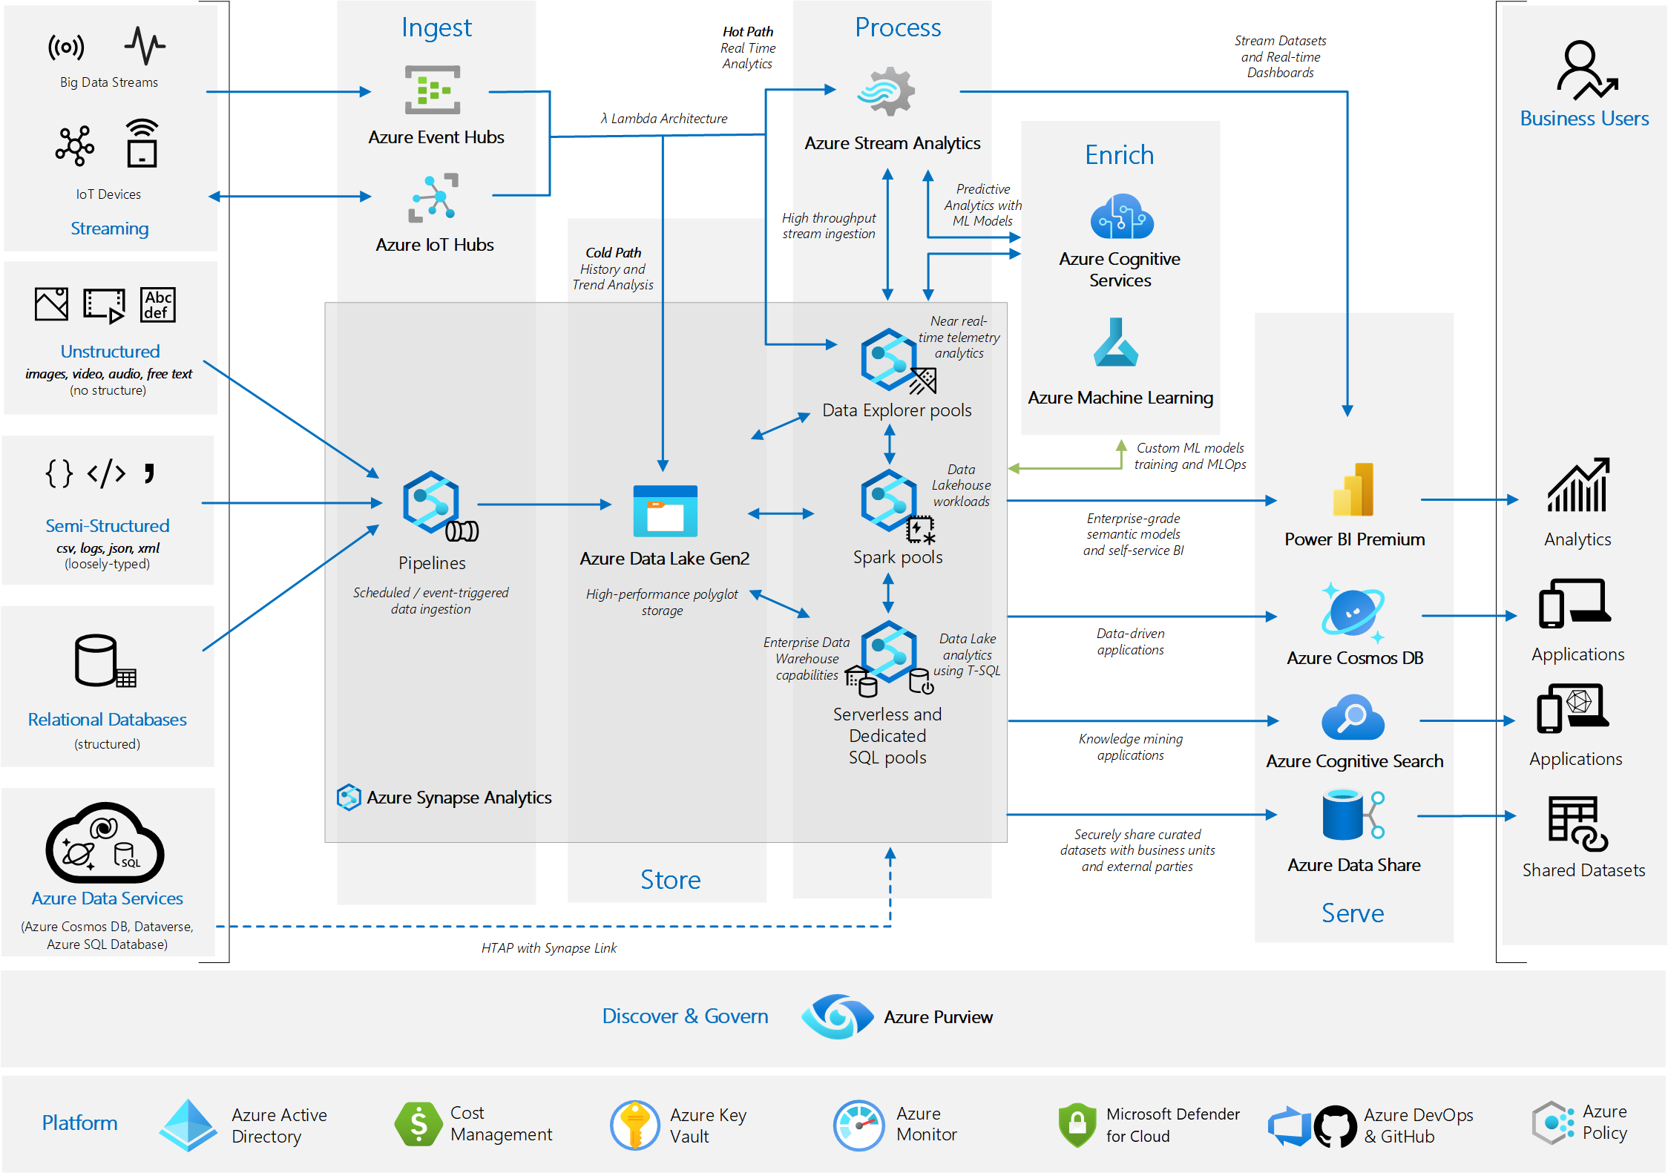
Example Architecture - Analytics end-to-end

Slide 7
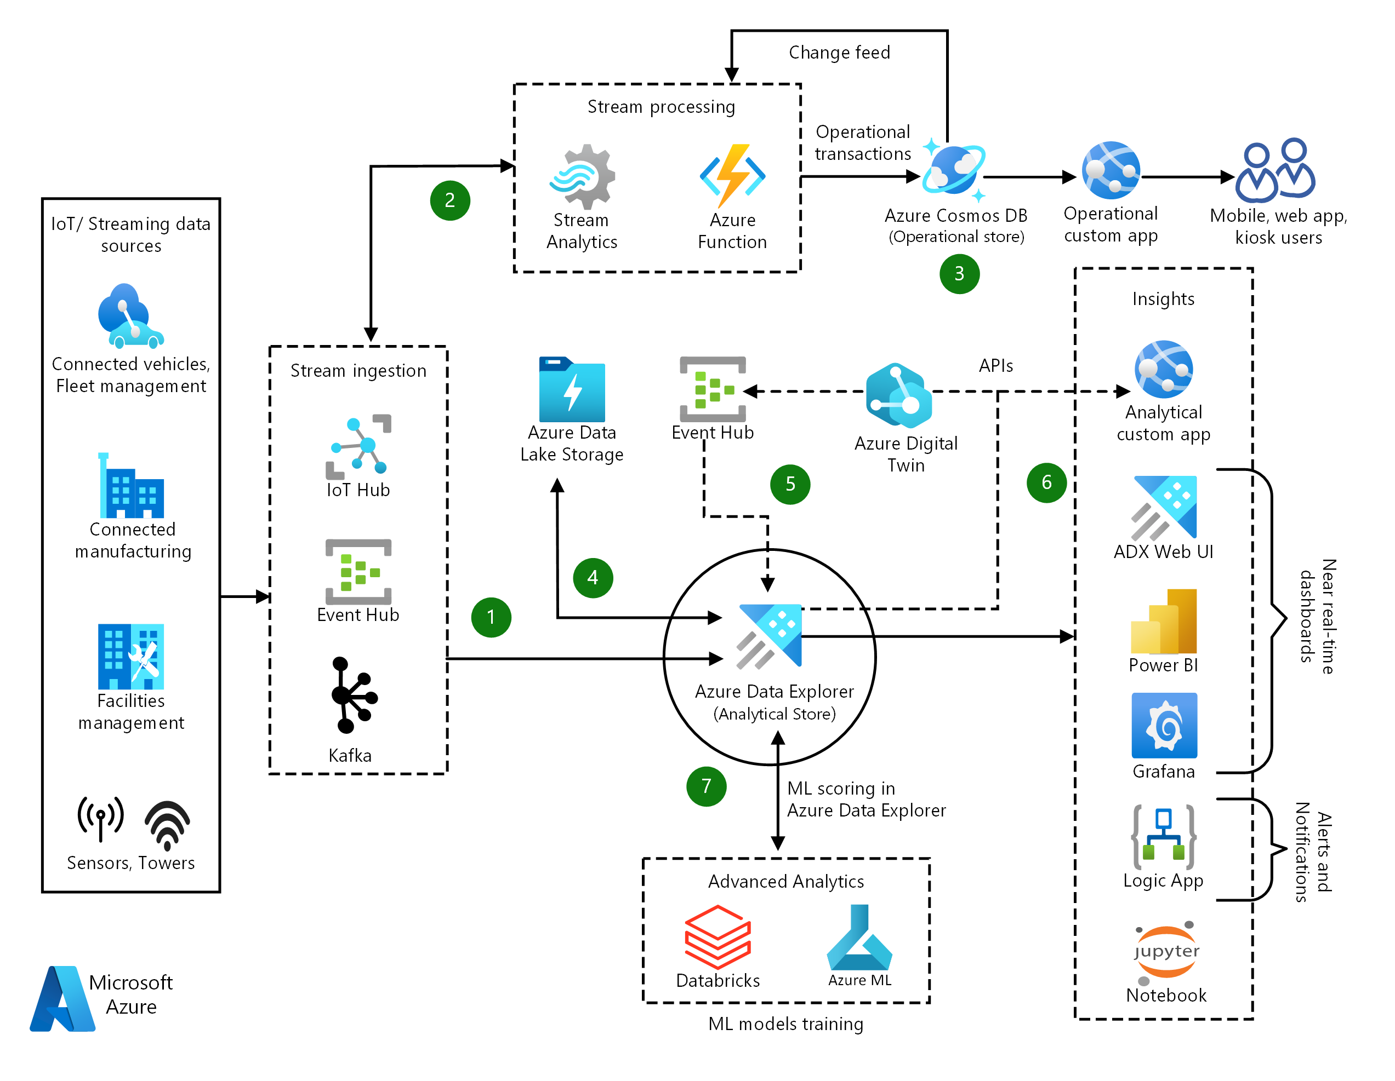
Example Architecture – Data Explorer

Slide 8
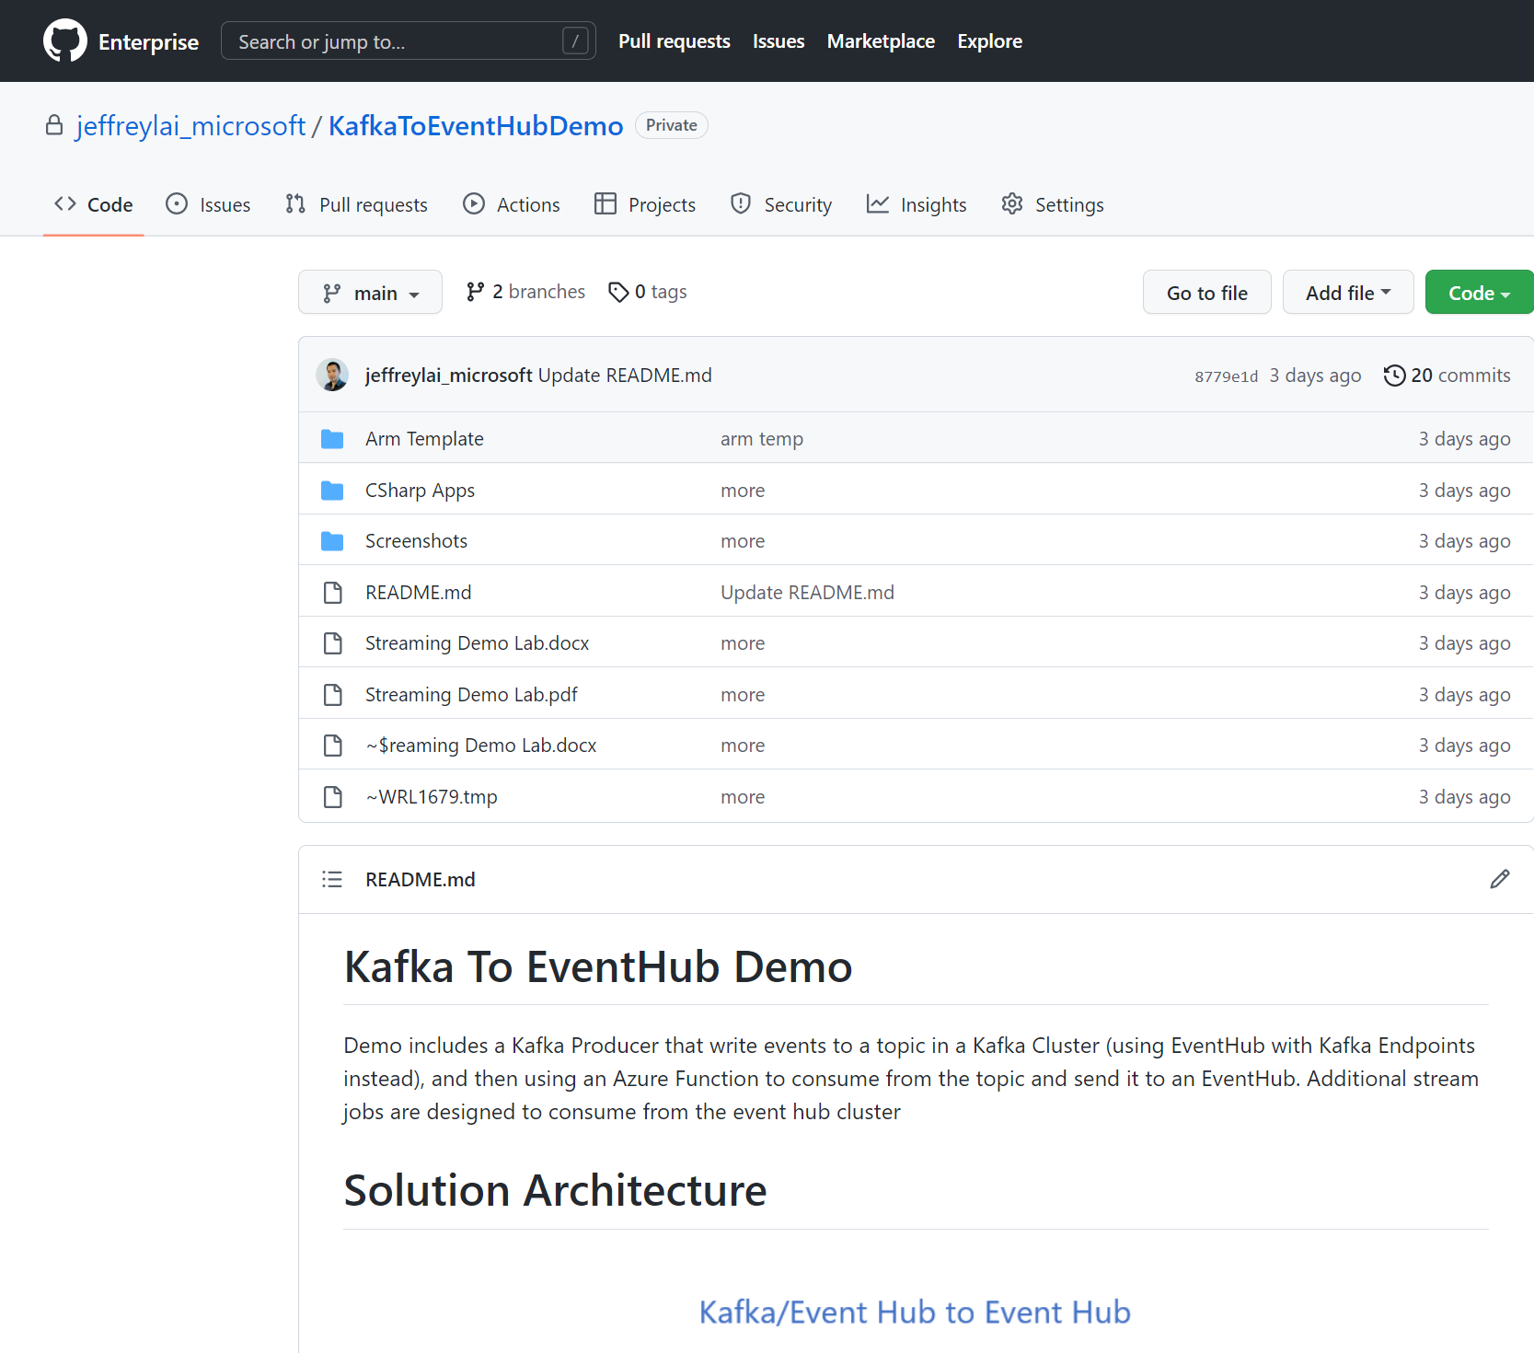
Lab Demo
7effrey89/Kafka-Topic-Replication-To-Kafka-EventHub: Demo includes Kafka Producer that write events to topics to Kafka Cluster (using EventHub with Kafka Endpoints instead), and then using an Azure Function to consume from the topic and send it to an Event Hub (github.com)

Slide 9
Lab Solution
Kafka/Event Hub to Event Hub
Device

Slide 10
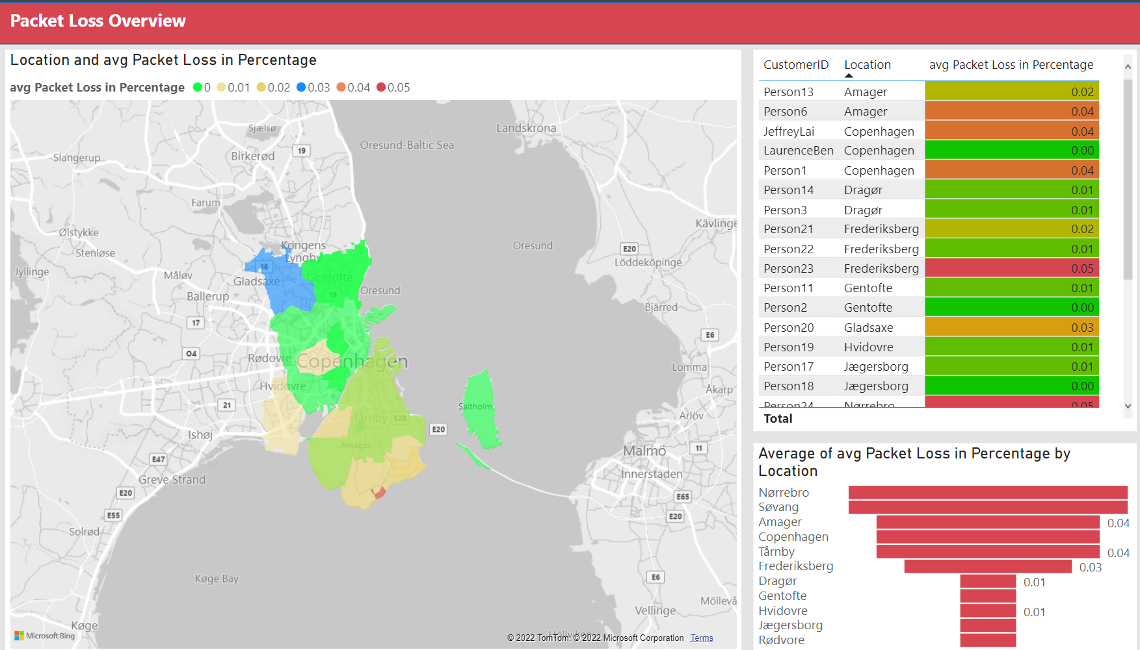
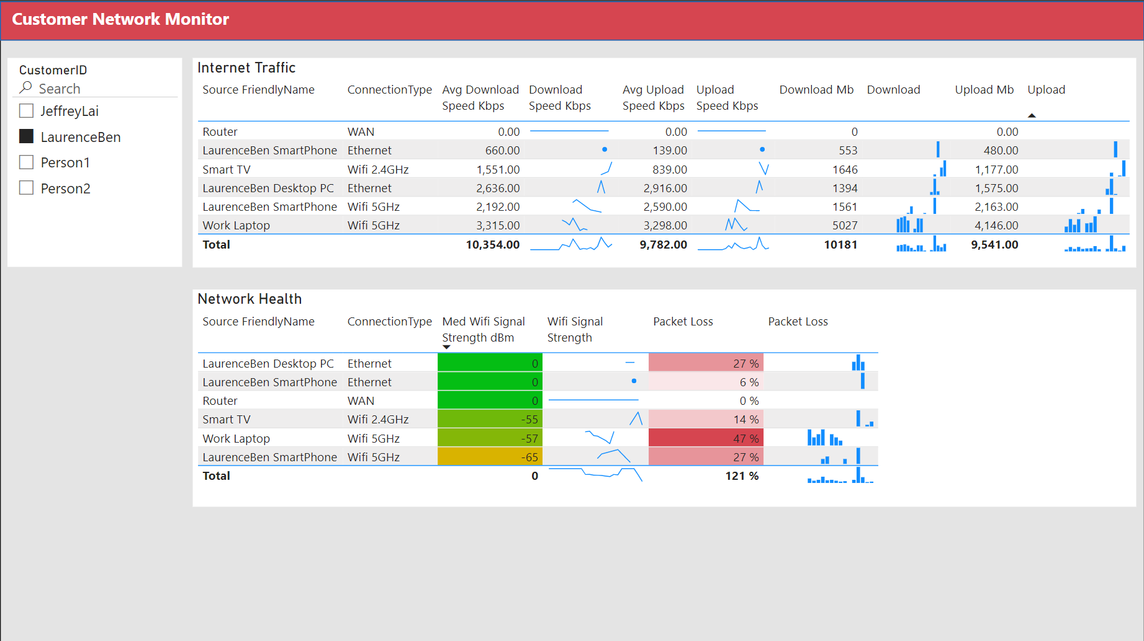
PowerBi Reports
StreamAggreationReport - Power BI Real Time Data
NetworkSimulation - Power BI – Data Exploration

